Slide 1
Support Vector Machine (SVM)
From Scratch

Slide 2
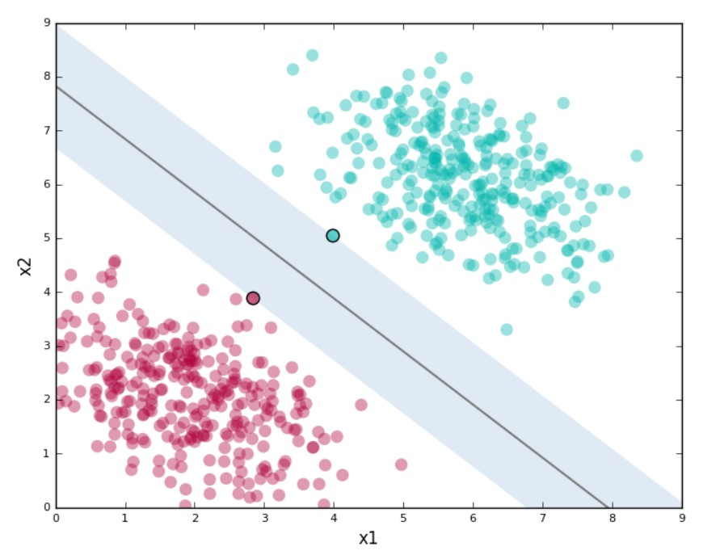
What is SVM?
Separate datapoints by hyperplane.
Maximum margin.
Only support vectors matter while
choosing hyperplane.
Support Vectors

Slide 3
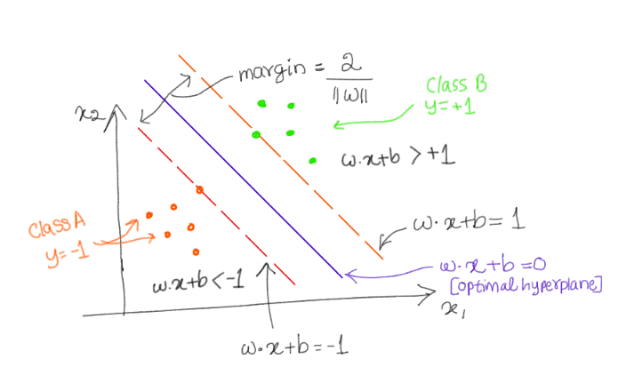
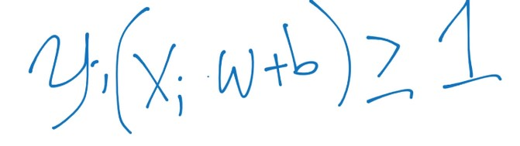

Slide 4
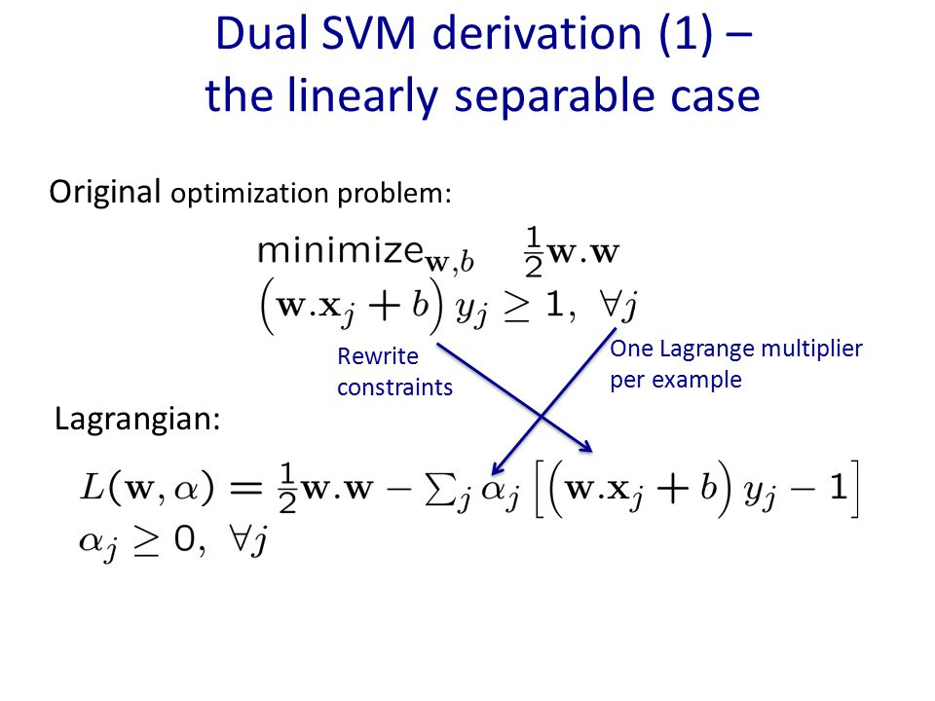

Slide 5
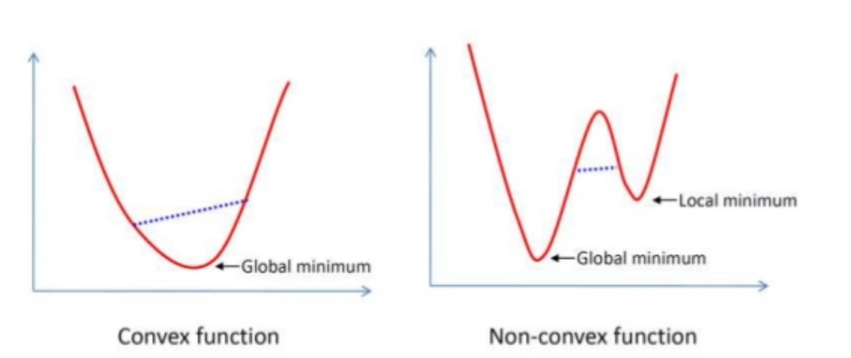
Unlike Neural Networks there is always a global
minima because its square optimization problem.

Slide 6
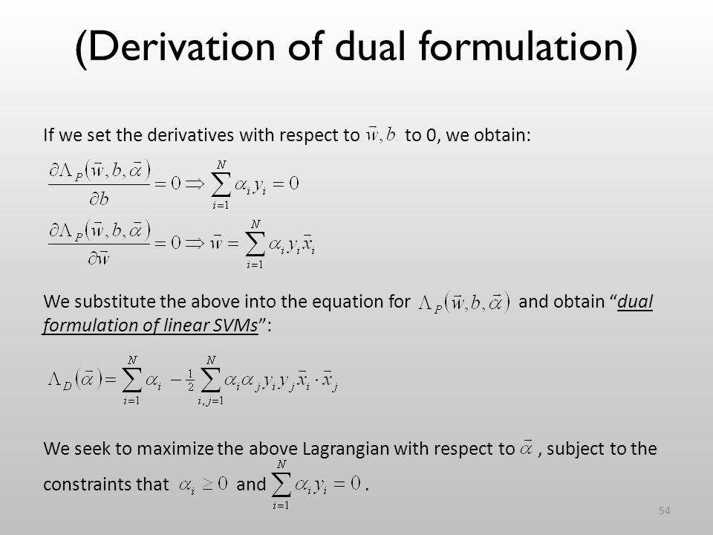

Slide 7
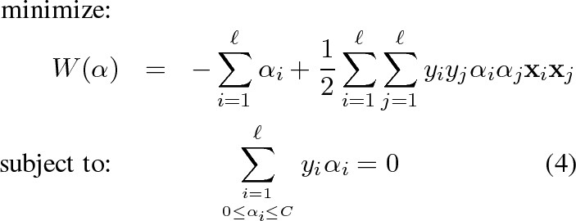

Slide 8
Sequential Minimal Optimization (SMO)
Minimize with one alpha at a time.
From second case, just one alpha cannot be tweaked independently
so, another alpha need to change with it to balance the effect and
make total sum still zero.

Slide 9
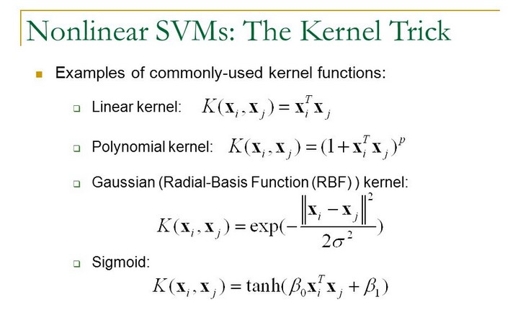
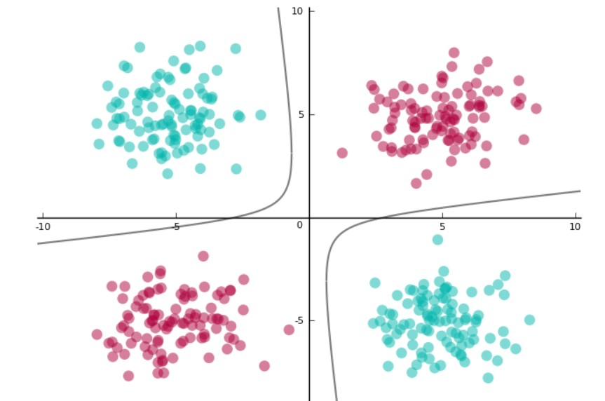

Slide 11
Demo
UCI Iris dataset
Over 150 datapoints.
3 type of Iris, distinguishable by their sepals and petals
Features fairly linearly separable i.e can work without Kernels

Slide 12
What I did?
Implemented binary classifier with SMO + RBF kernels following the pseudocode and Andrej Karpathy’s code.
Made multiclass classifier using one vs all approach:
1) Separately train against all classes (eg. +1 in that class, -1 not in that class).
2) Combine the individual results to give the multiclass result.
To combine, I came up with following heuristics:
If only one class is +ve than choose that
If more than one class is +ve than choose one one which is the most positive
If no class is +ve than choose the one which is least negative

Slide 13
Thank You

